Slide 1
Query Dependent Ranking Based on Query Clustering
From 2013 IAES journal

Slide 2
Idea
Use different ranking model to rank different queries.
Steps:
Cluster the query train set
Choose the best cluster for query
Rank the query with the selected model

Slide 3
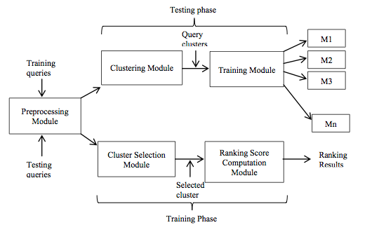
System

Slide 4
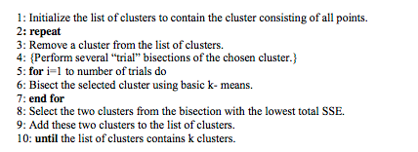
Cluster module
Choose bisecting k-means algorithm as the cluster alg.

Slide 5
Ranking module
Choose Ranking SVM as the ranking model for each cluster
What’s Ranking SVM?
Treat the ranking problem as a classification problem.
Find a hyperplane to divide the data

Slide 6
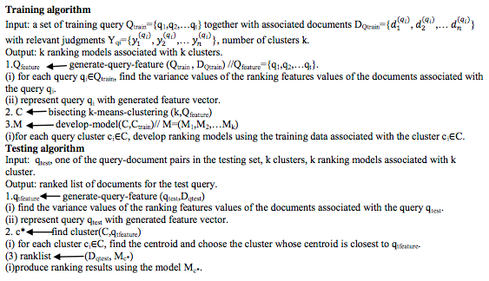
Training Algorithm

Slide 7
Experiments
Dataset
TREC2003, TREC2004, OHSUMED
Evaluation Measure
P@n
MAP

